Slide 1

Laptop Price Prediction Using Machine Learning
CAPSTONE PROJECT
NITIN

Slide 2

Problem:
What are we solving? Predicting laptop prices based on their specifications.
Why is it important?
Informed consumer decisions
Better retail pricing strategies
Market analysis
Recommendation systems

Slide 3

Project Requirements
Data Exploration & Visualization
Data Cleaning
Feature Engineering
Exploratory Data Analysis (EDA)
Machine Learning Modeling
Optional Deployment

Slide 4

Dataset Overview
Source: Kaggle
Key Features: Company, Type, CPU, RAM, GPU, Memory, Screen, etc.
Target: Price

Slide 5
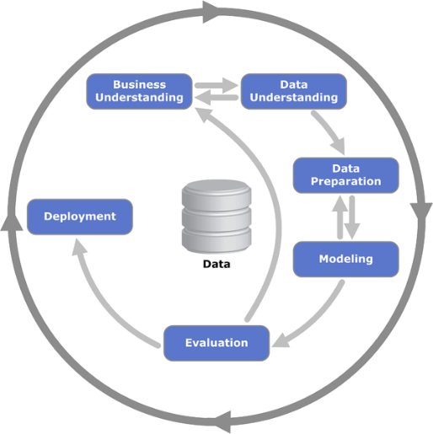
Methodology (CRISP-DM)
Phases:
Business Understanding
Data Understanding
Data Preparation
Modeling
Evaluation
Deployment (optional)

Slide 6

Data Understanding
Explored feature distributions
Found positive skew in many features
Identified trends using boxplots (e.g., RAM vs Price)

Slide 7
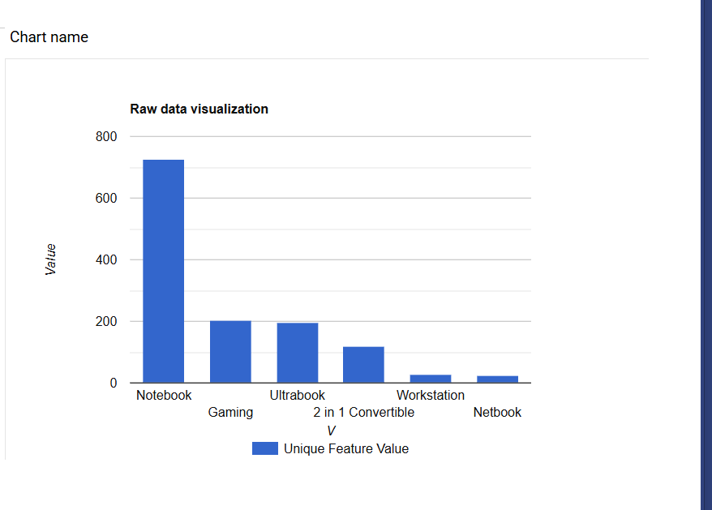
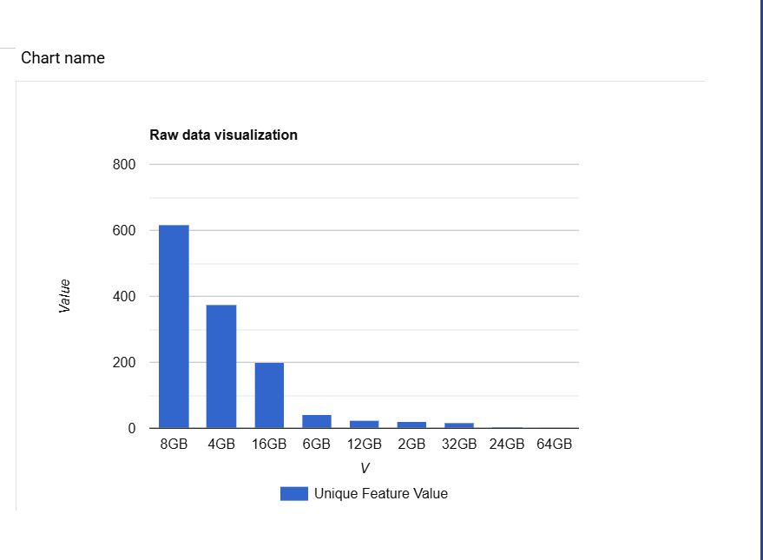
Distribution
Laptop TypeName Distribution
Memory distribution
All the columns in the dataset are positively skewed
some of the distribution of the datasets showing positive skew.

Slide 8
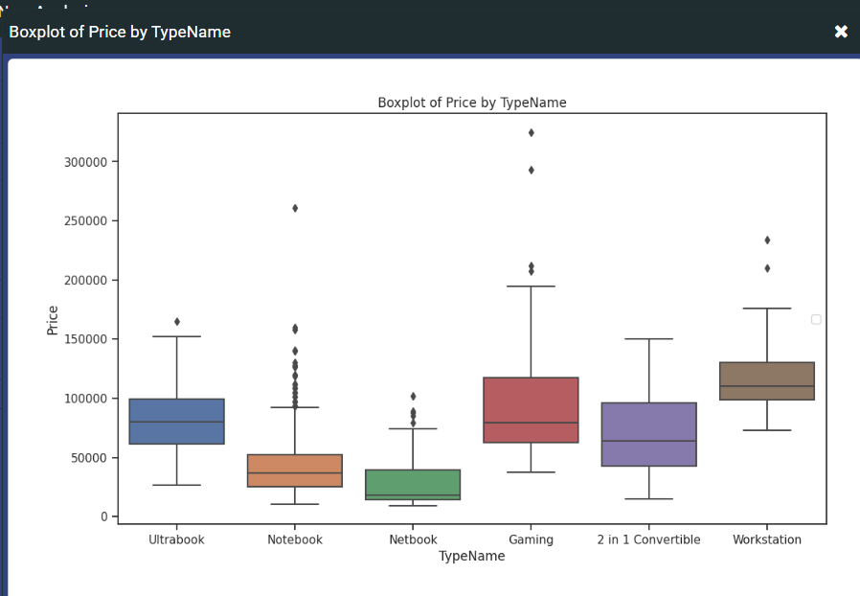
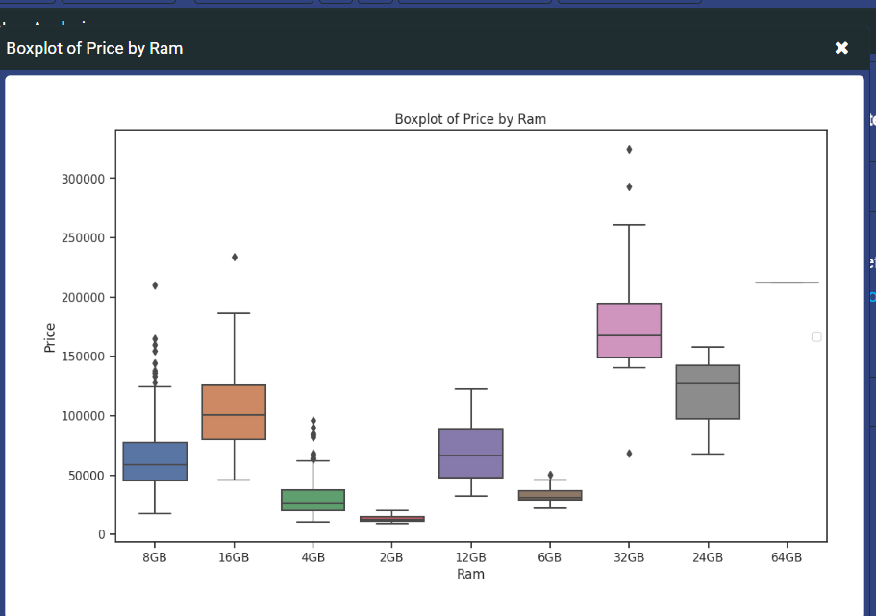
Relationships
Boxplot of Laptop Price by Type
Boxplot of Laptop Price by Ram
Using the boxplot, we can see from the above diagram how Laptop type or Ram affects price
Trends and outliers in numeric and categorical data.

Slide 9
Data Preparation
No missing values
Removed unnecessary columns (e.g., “Unnamed”)
Split: 80% train / 20% test
Converted categorical features to numerical

Slide 10
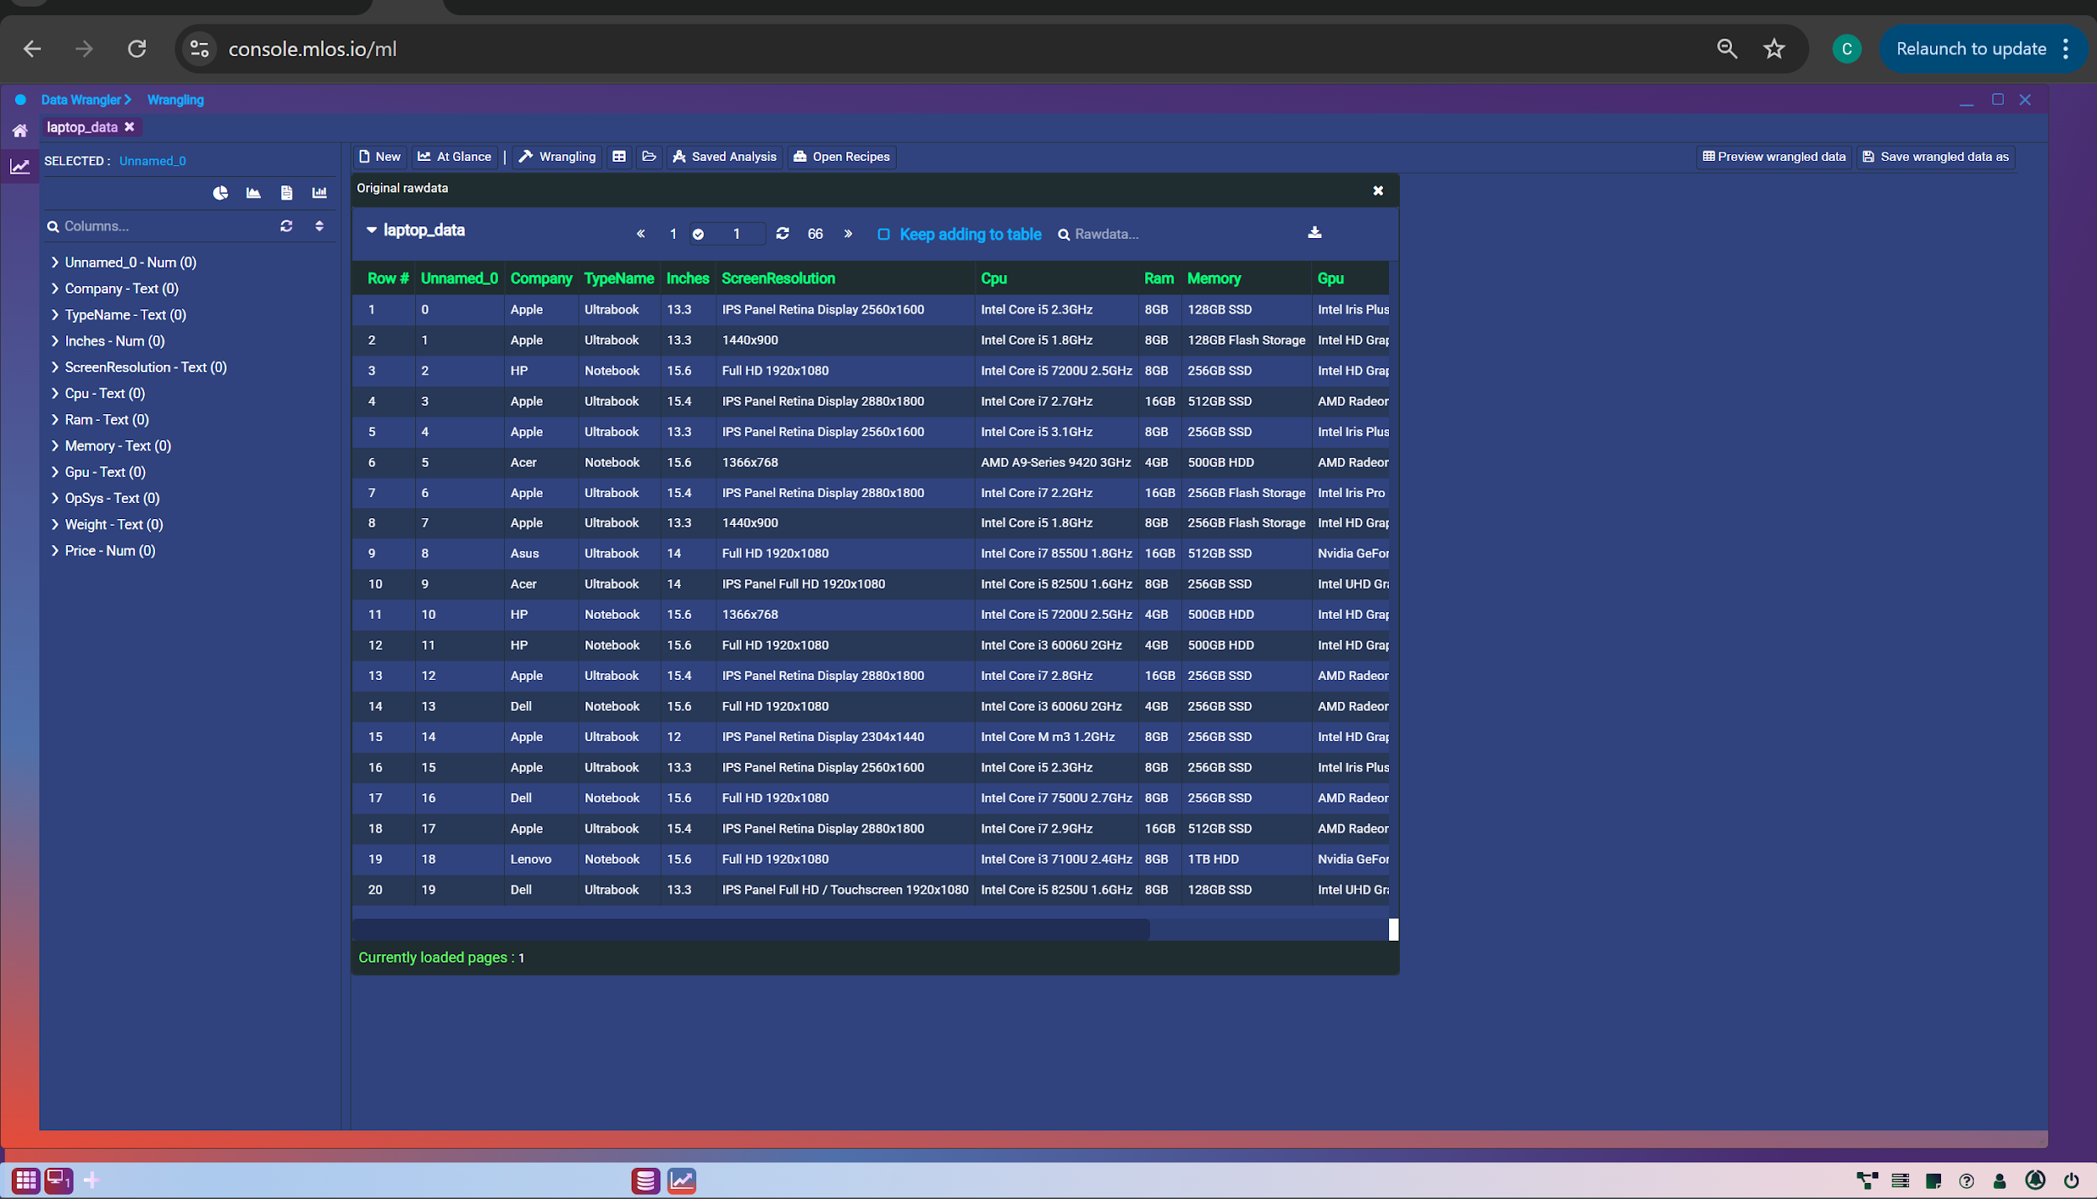
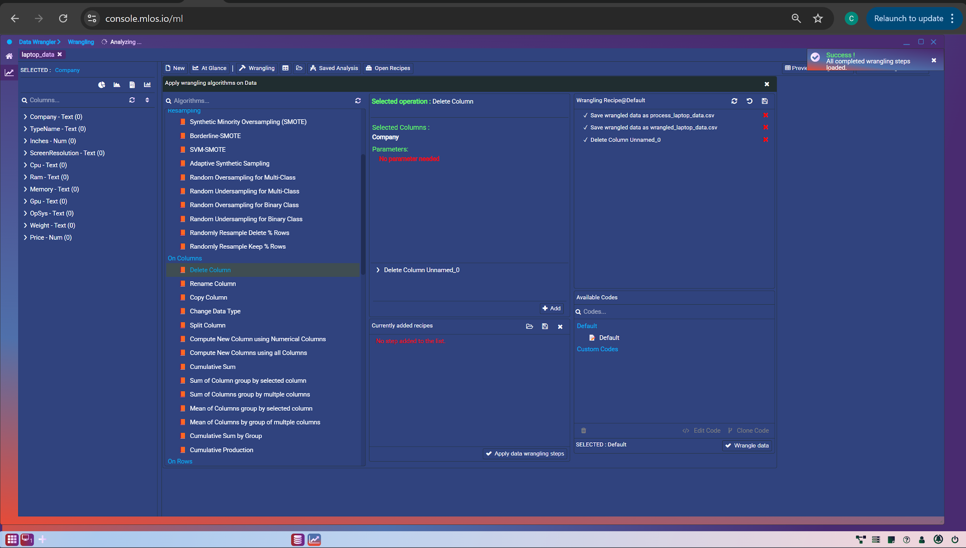
Data Preparation
Remove unnecessary columns like (Unnamed)
Defining the Dataset
“We then defined our final dataset, carefully selecting features that influence price and are available during real-world predictions.

Slide 11
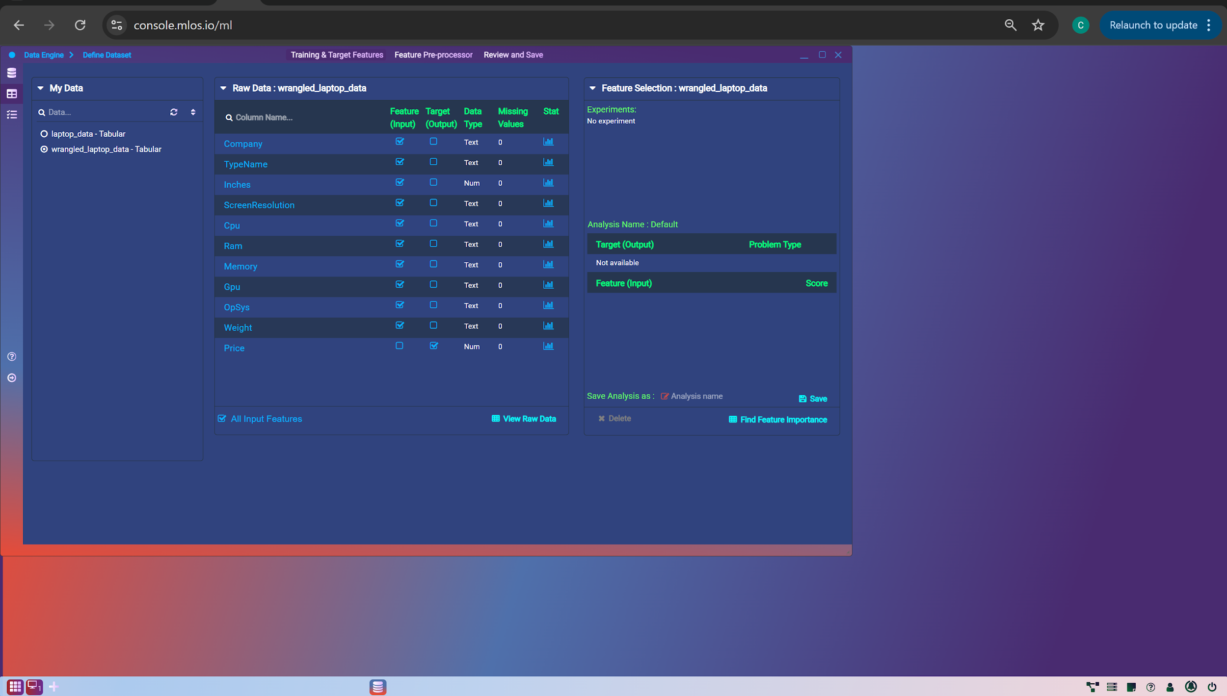
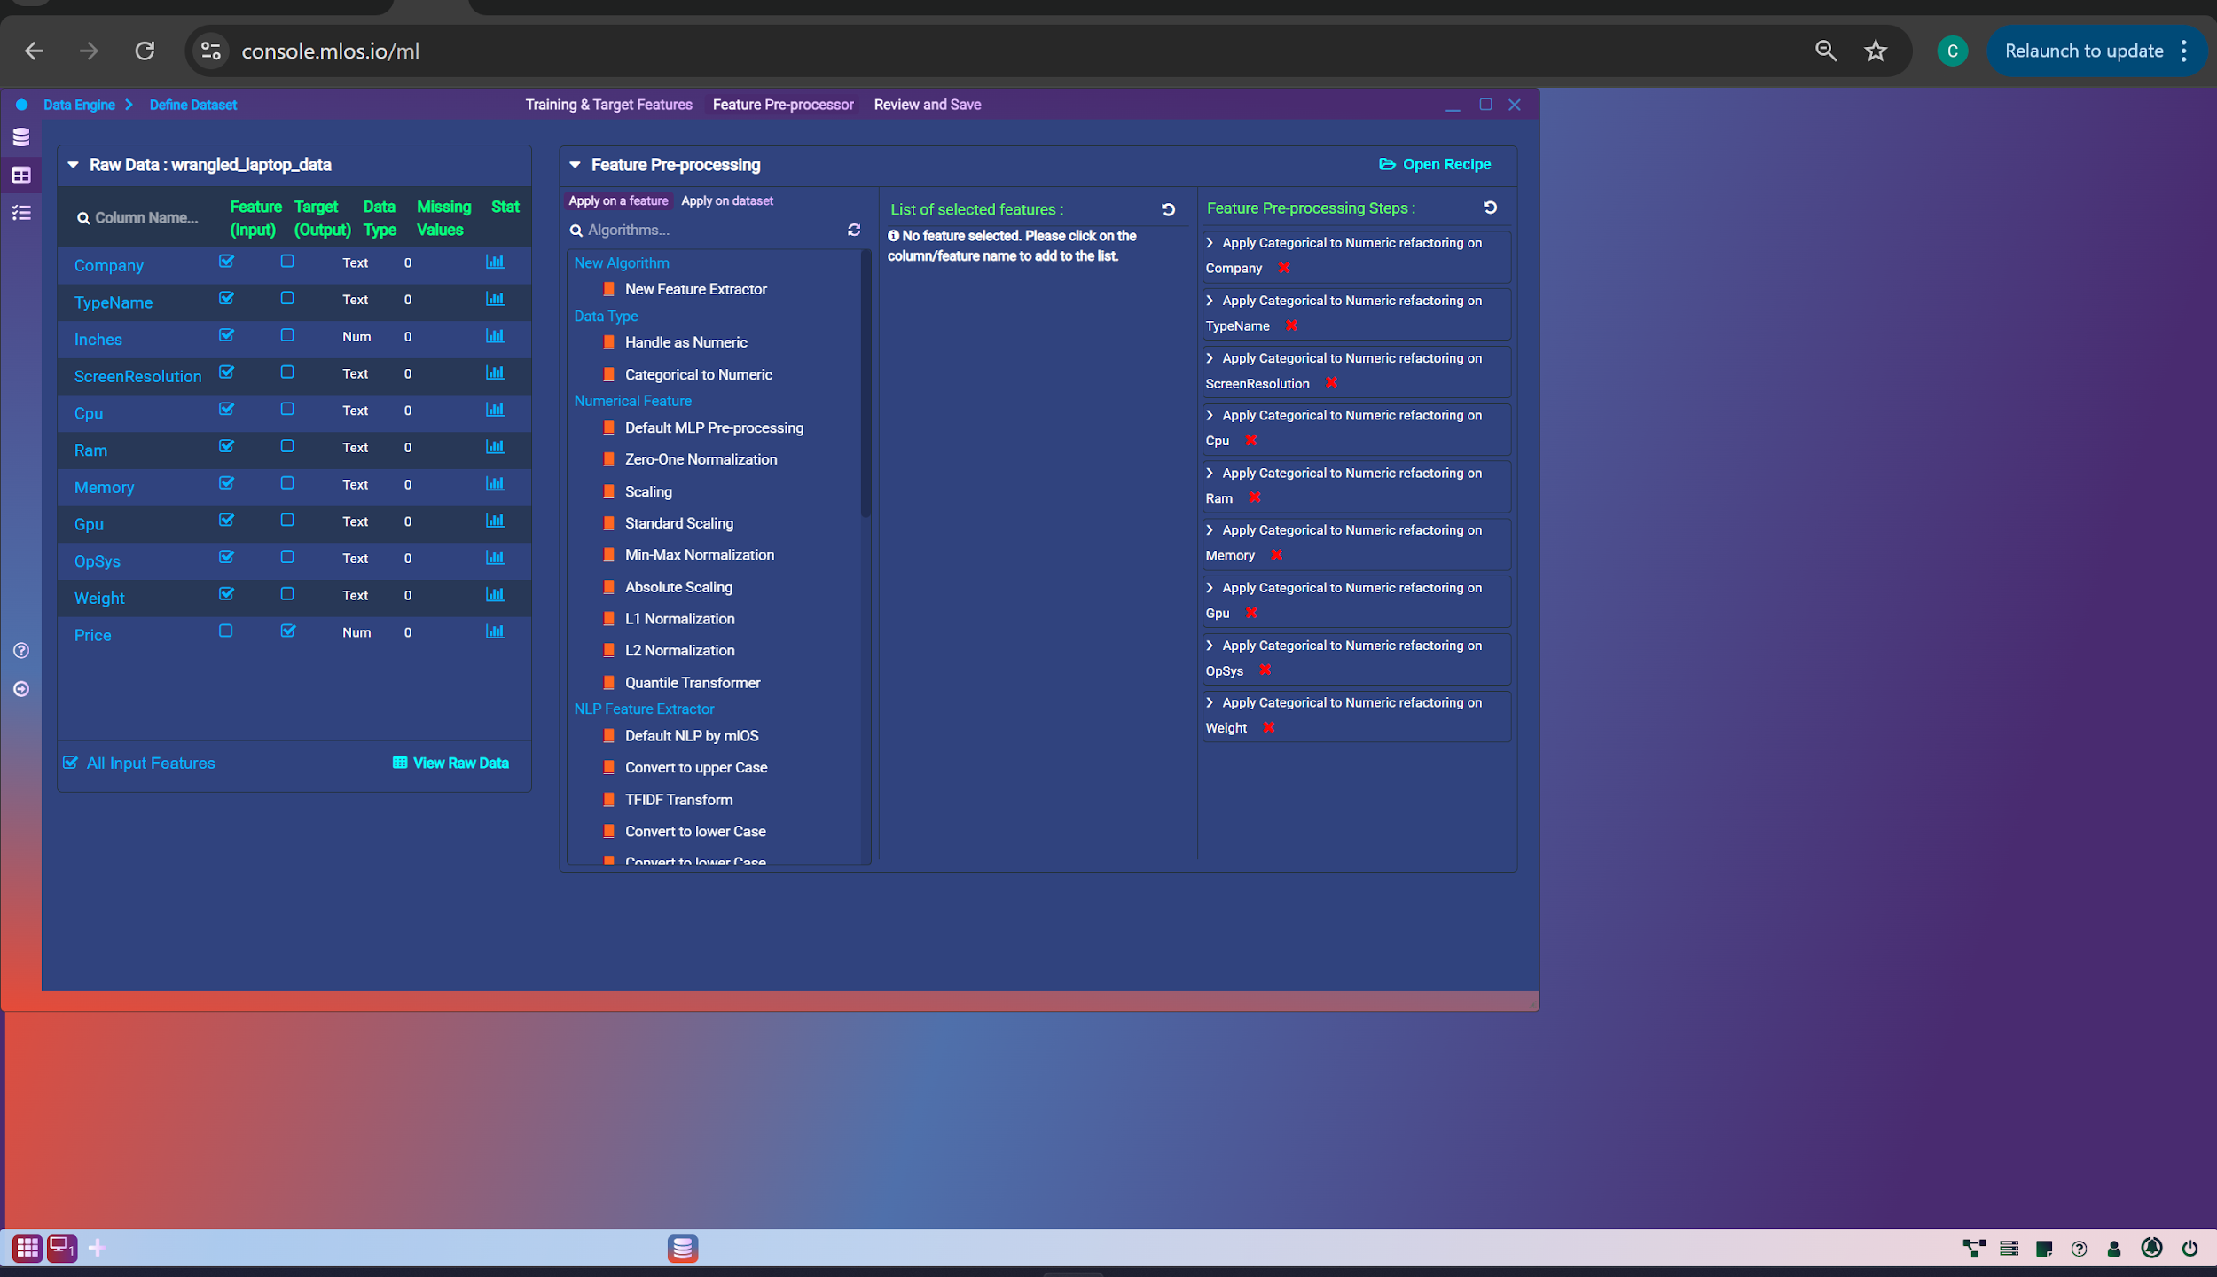
Data Preparation
Feature Pre-processing Steps:
Since machine learning models require numeric input, we converted all categorical variables such as ‘Company’ or ‘Laptop Type,’ into numeric values using encoding techniques like Label Encoding or One-Hot Encoding. This step ensures that the model can correctly interpret the categorical data.”

Slide 12
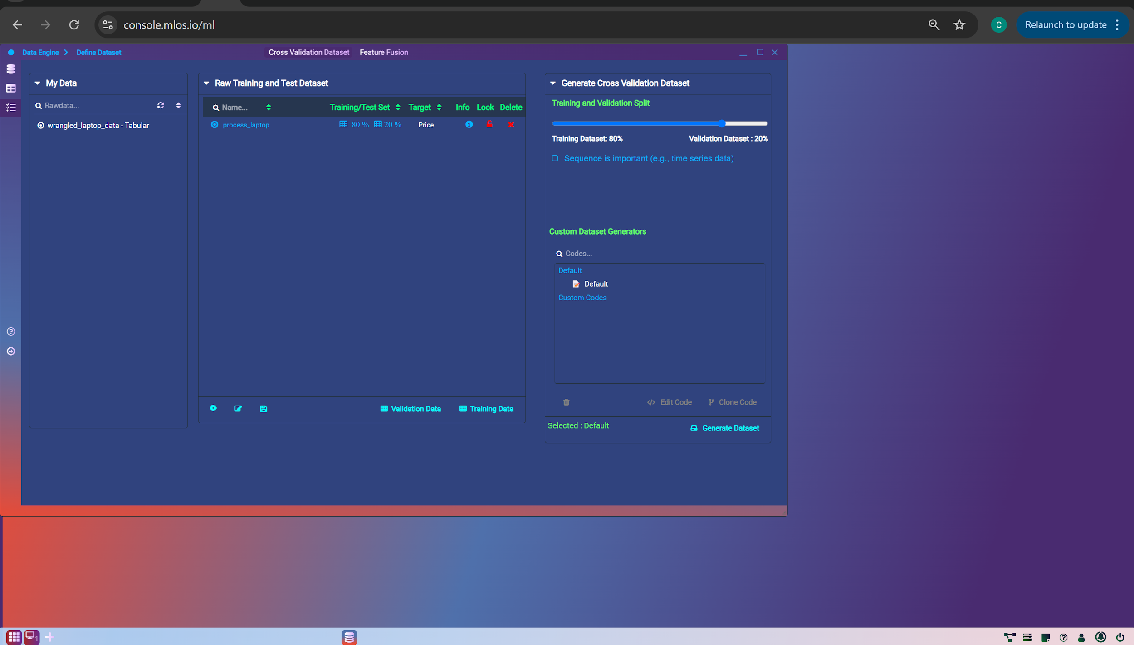
Data Preparation
Split the dataset into 80% training and 20% testing sets by defining the dataset.
This is a standard approach to evaluate model performance – the model learns on the training set and is tested on new, unseen data. It helps us measure how well the model generalizes to real-world inputs.”

Slide 13
Model Selection
Algorithms Used:
1. Random Forest Regressor
2. Extra Trees Regressor
3. Decision Tree Regressor
Reason: Tree-based models handle non-linear relationships well

Slide 14
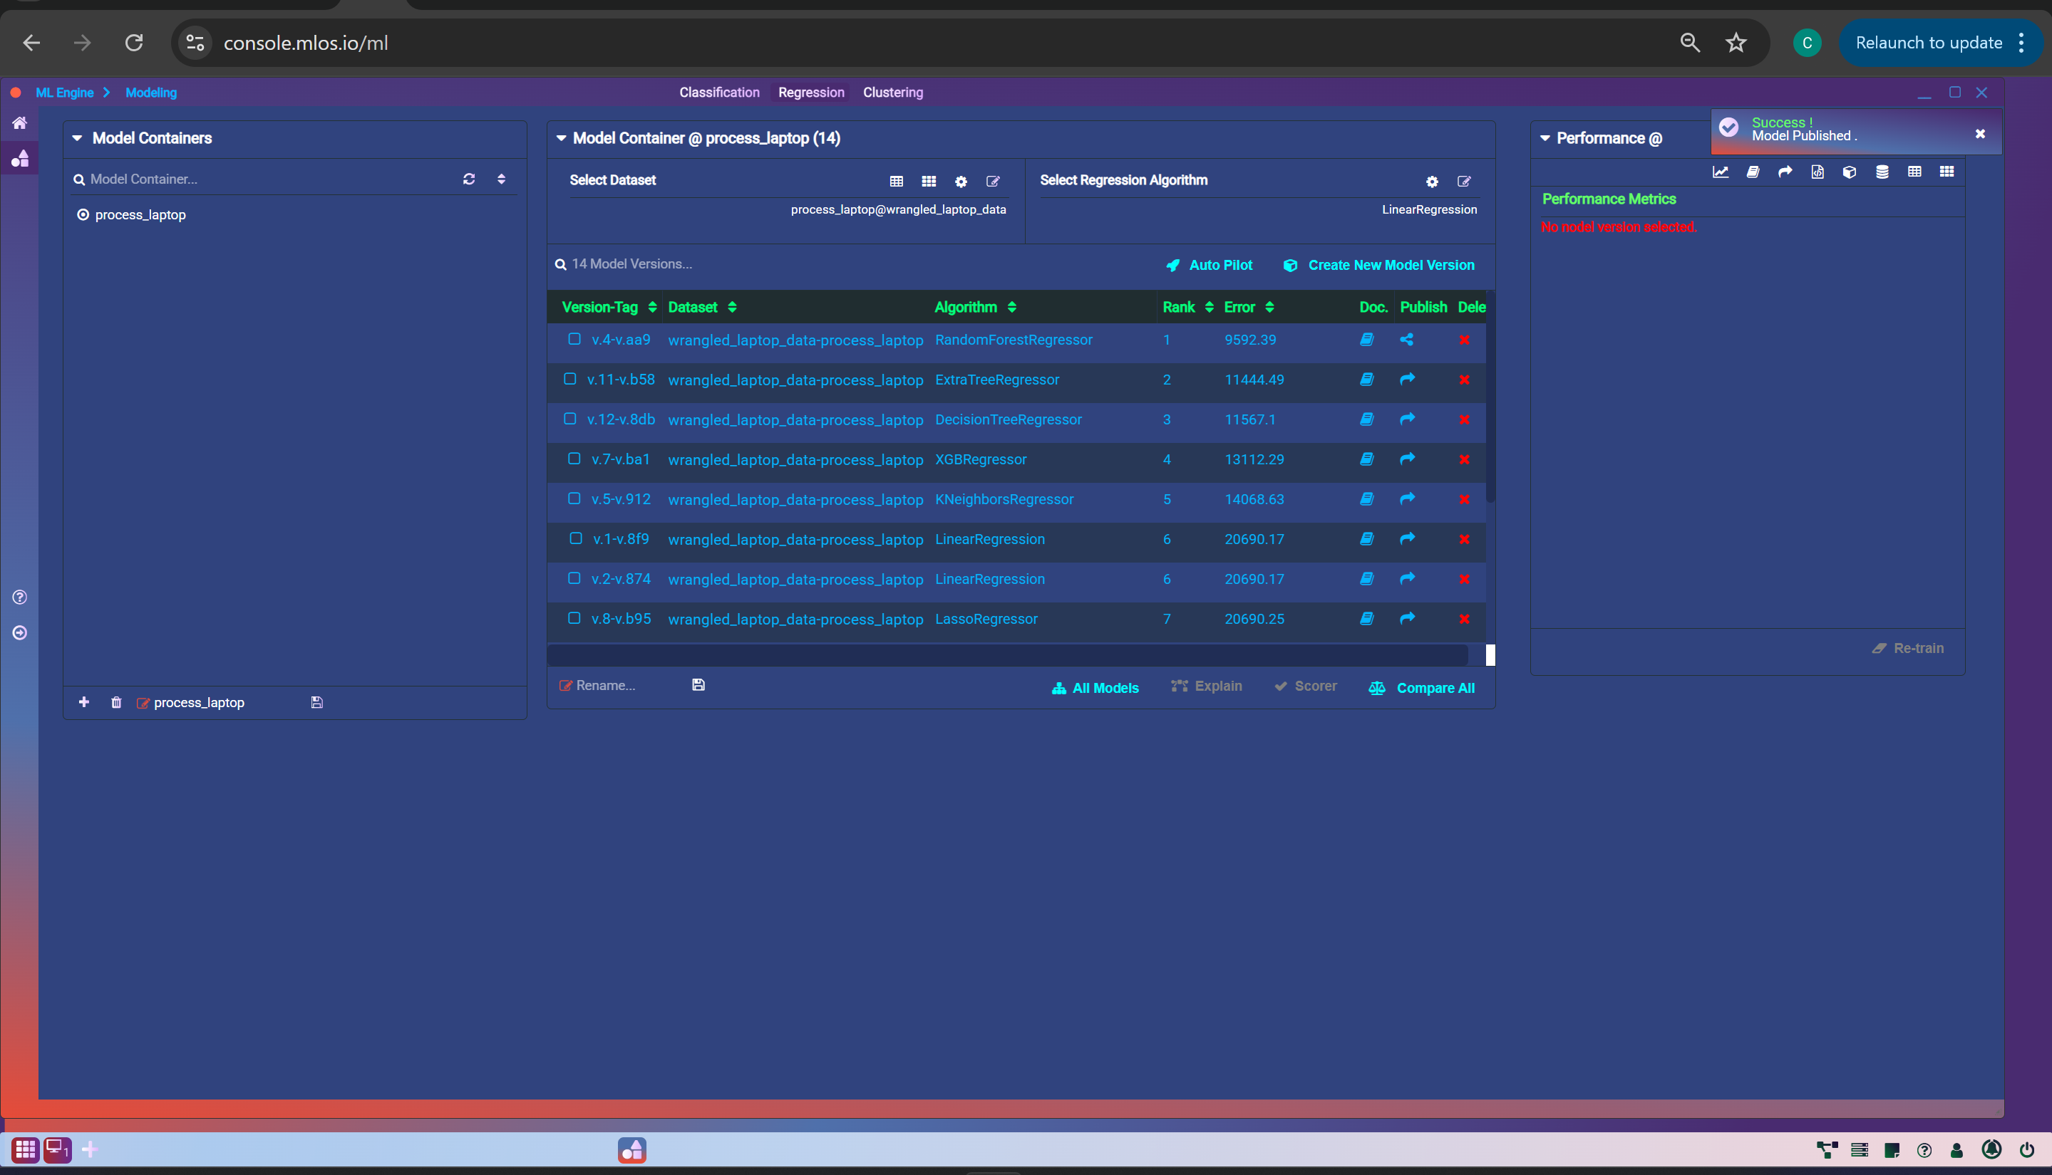
Algorithms Used

Slide 15
Model Performance Comparison & Evaluation
Model | RMSE | MAE | MSLE | Median Error
Random Forest | 15,272 | 9,592 | 0.0436 | 6,124
Extra Trees | 19,059 | 11,444 | 0.0708 | 6,175
Decision Tree | 19,235 | 11,567 | 0.0741 | 5,860

Slide 16




Best Model - Random Forest
Best overall accuracy
Balanced performance across all metrics
Robust and handles feature importance well
(prediction vs actual graph)

Slide 17
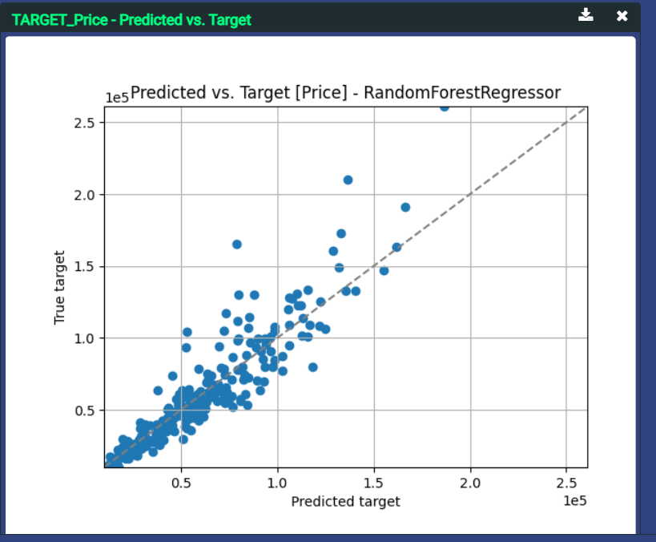
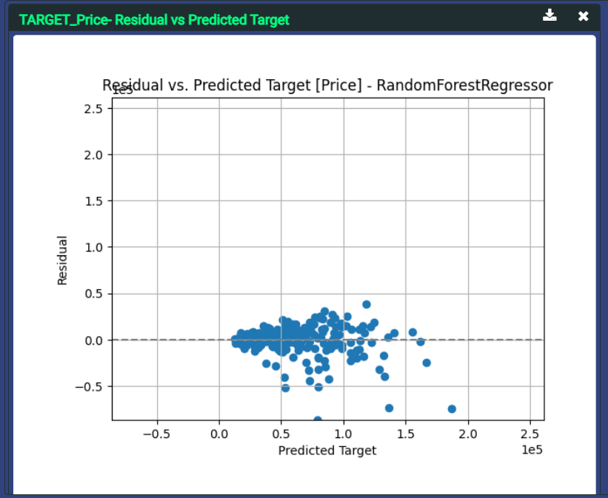
Random Forest Graph Analysis
Target_Price Predicted vs Target
Target_Price Predicted vs Residual

Slide 18
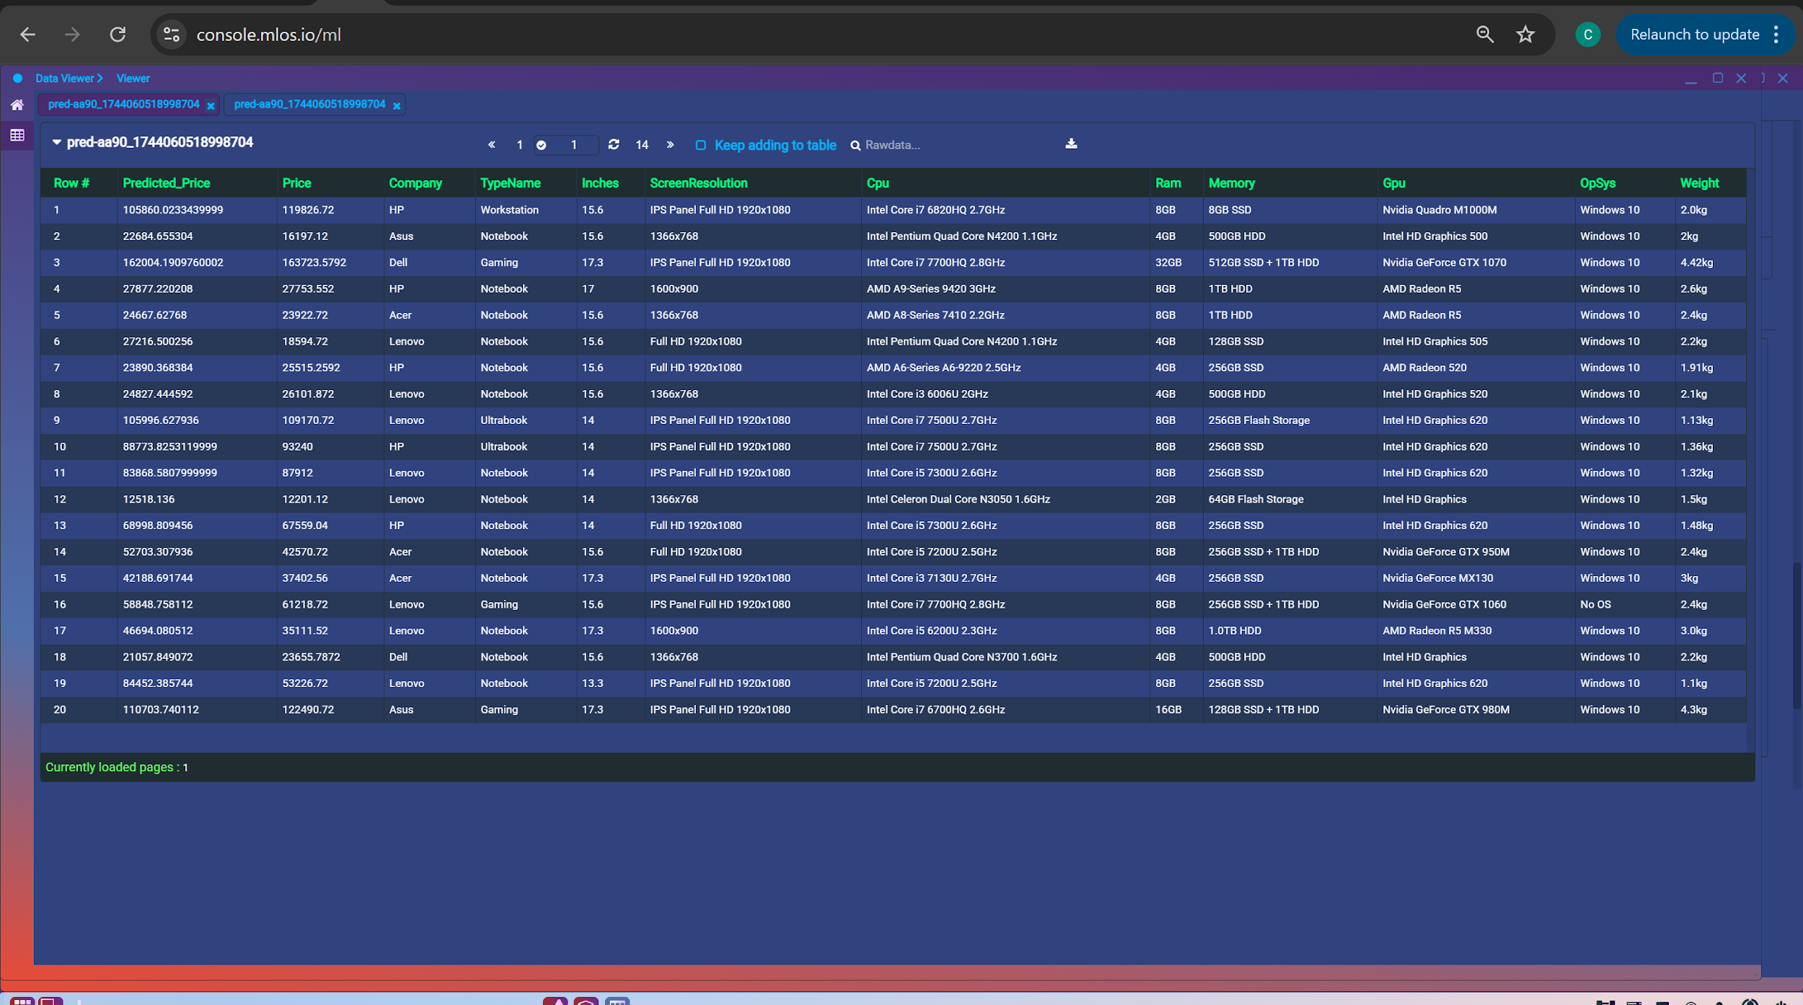
Random Forest Original Vs Predicted

Slide 19

Deployment Overview
Model Governance Includes algorithm selection, data preprocessing, and feature engineering steps
Performance Metrics & Justification
Used multiple metrics to evaluate model fairness and effectiveness:
Mean Squared Error (MSE)
Mean Absolute Error (MAE)
Mean Squared Log Error (MSLE)
Random Forest Regressor chosen as the most reliable model

Slide 20
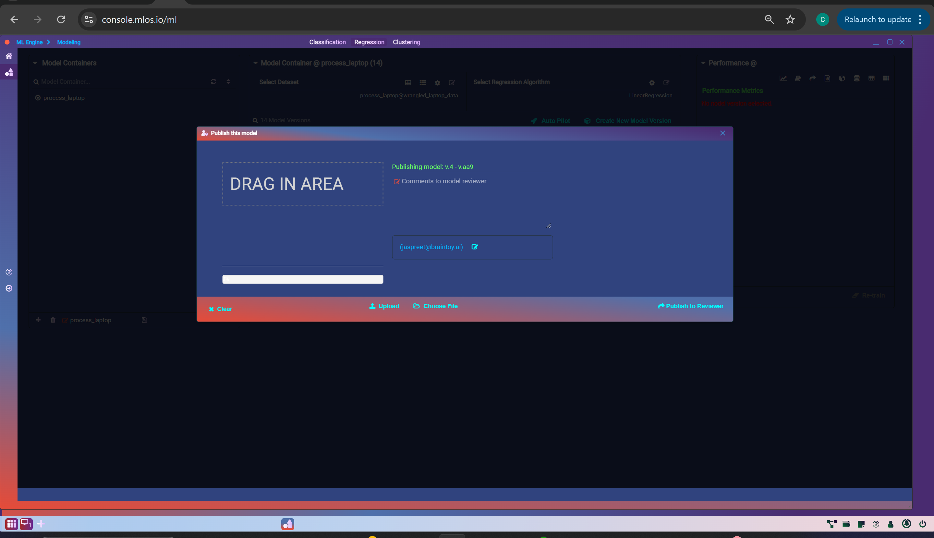
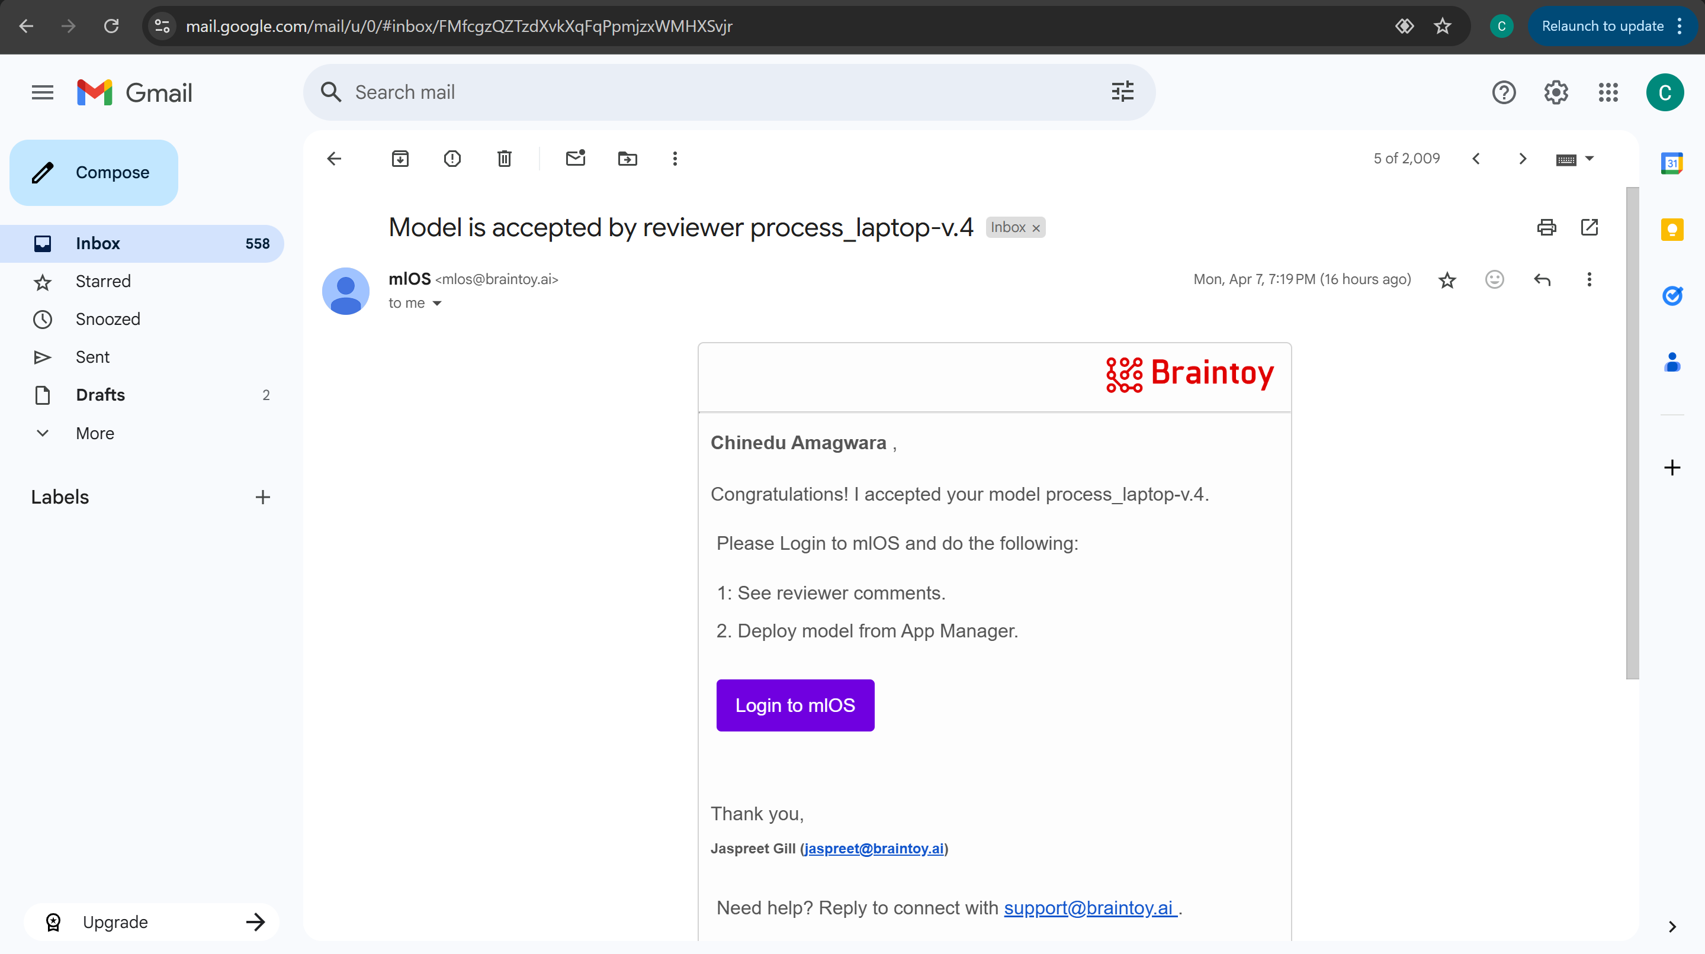
Model Publishing
Publishing model to instructor
Model Approved

Slide 21
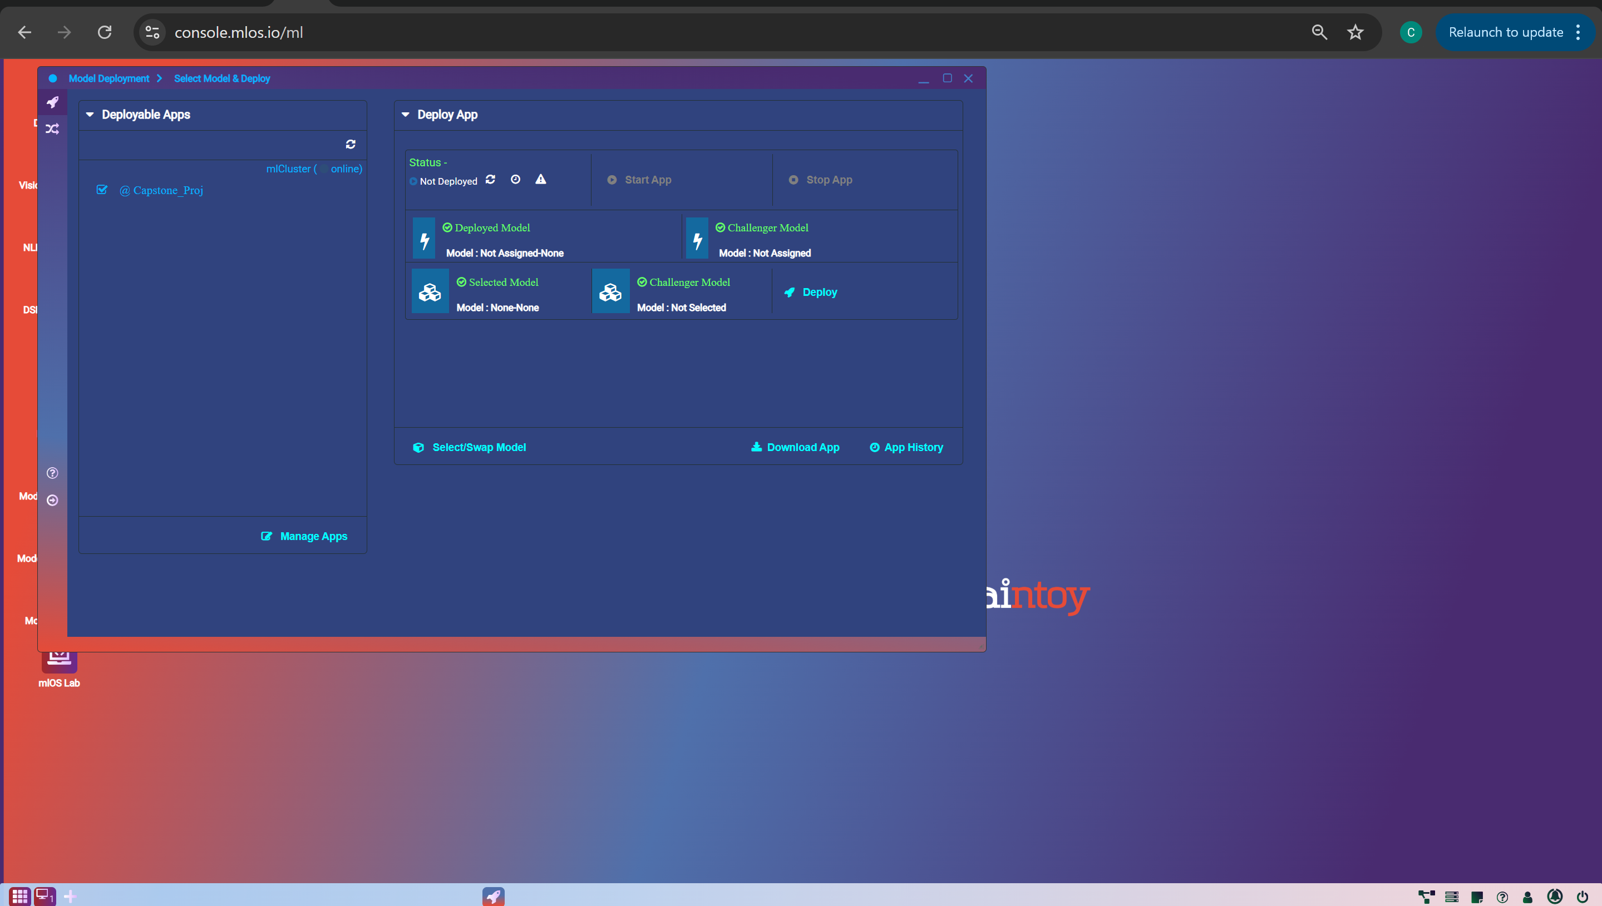
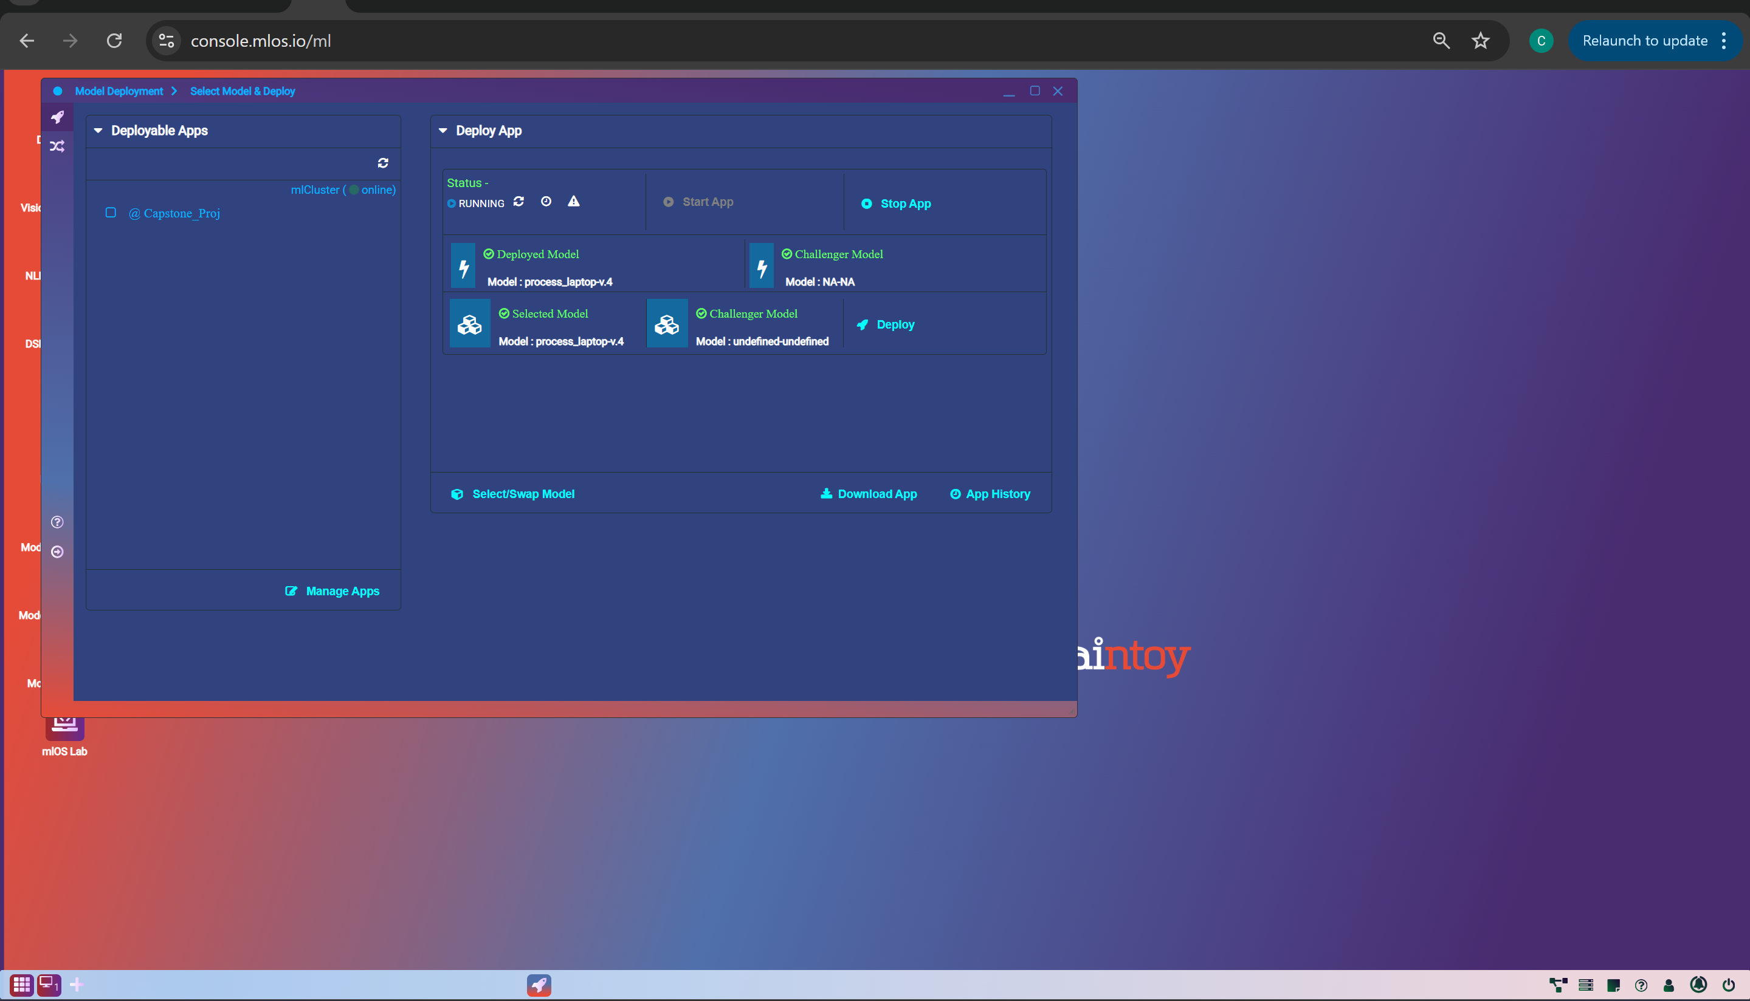
Model Deployment
Creating Container for the app
Model deployed
New app container serves as the workspace for linking models and generating API keys.
Within the newly created app container, we can see trained & approved Random Forest Regressor model and select that model for deployment.
Once deployed, the interface will update to indicate that the model is now active within the app container

Slide 22
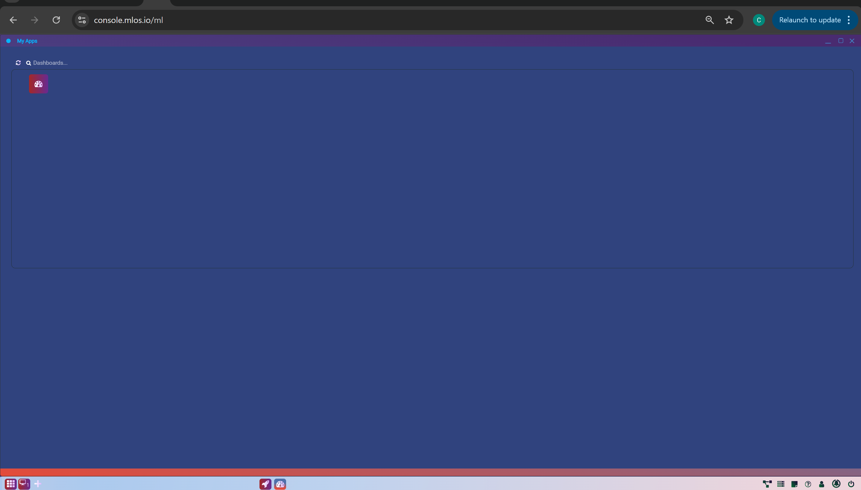
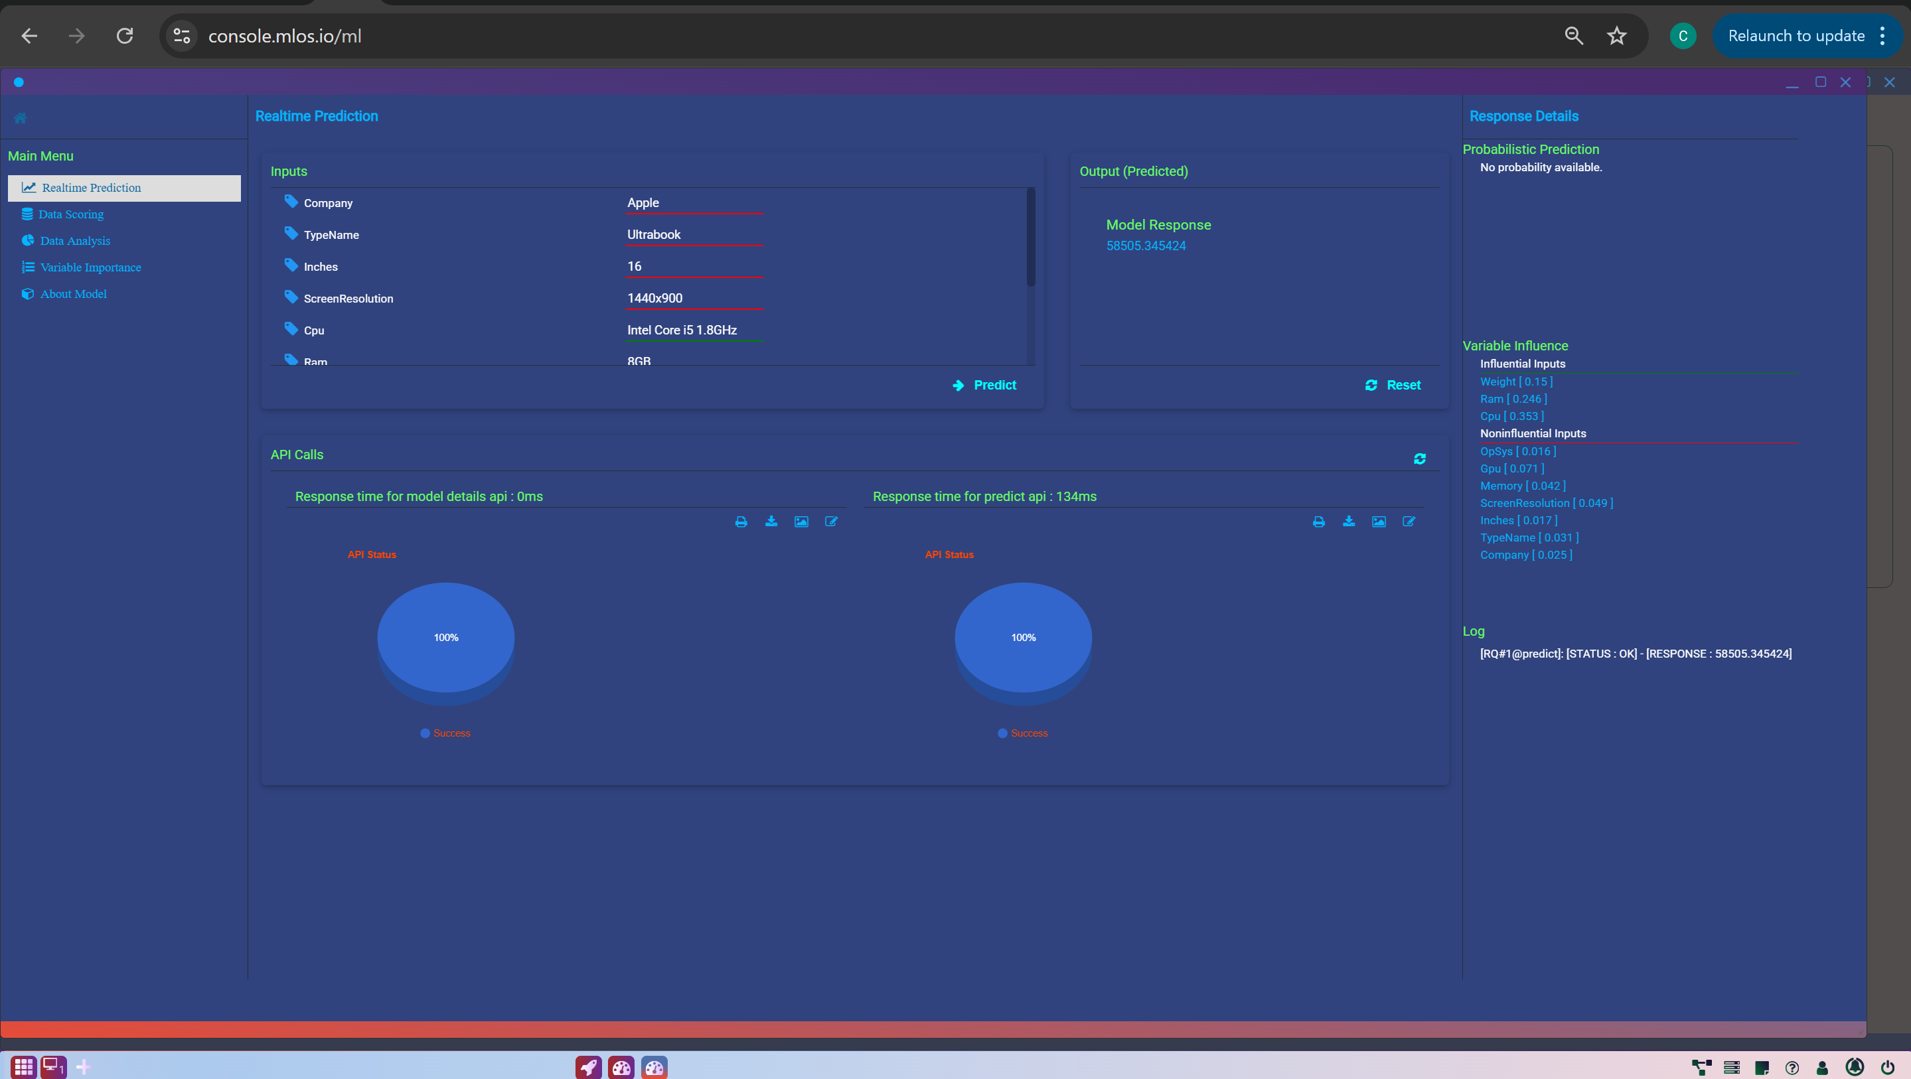
App Dashboard
Dashboard provides an overview of app activity, prediction logs, input/output behavior, and other relevant information
The deployed Random Forest model successfully predicted a laptop price of 58,505.35, showing that the model is operational and responsive to new inputs

Slide 23
Conclusion
How Can This Solution Be Used?
Organization, such as an e-commerce platform, electronics retailer, or supply chain manager, can implement this laptop price prediction model
🔍 Predict fair market prices for incoming laptop inventories
💡 Recommend price ranges to customers and partners
🛒 Identify over-/underpriced listings on e-commerce platforms
🔁 Support trade-in & refurb programs with accurate price baselines
📊 Integrate into dashboards for real-time pricing insights
🎓 Educational Use: Demonstrate ML applications in pricing strategy

Slide 24
Conclusion
Lessons Learned & Opportunities for Improvement
🧹 Data quality & preprocessing are vital for model success
🌳 Ensemble methods (e.g., Random Forest) perform well in regression
🔎 Model interpretability builds stakeholder trust

Slide 25




Future Improvements
Expand dataset to cover more laptop types, brands & specs
Integrate external data (e.g., market trends, ratings, historical pricing) for richer predictions
Deploy as a web app or API with user authentication & real-time monitoring
Explore advanced algorithms like Gradient Boosting & XGBoost

Slide 26

Thank You

